Slide 1
Variables & Type Casting, Operations
Marek Kwasniewski
Automation & Tooling

Slide 2
CMD & Term
Windows – CMD
CD – Change Directory – IE CD Documents
CD .. – Change back a directory
CD \ - Root Directory – C:\
dir – show directory contents
python – executes application python
MACOS - Terminal
CD – Change Directory – IE CD Documents
CD .. – Change back a directory
CD \ - Root Directory
LS – Lists directory contents
python – executes Python Applications

Slide 3
Indentation and Blocks
Python uses whitespace and indents to denote blocks of code
Lines of code that begin a block end in a colon:
Lines within the code block are indented at the same level
To end a code block, remove the indentation
You'll want blocks of code that run only when certain conditions are met
Example: (Python Devs be like, "Semi colons and curly braces are NOT needed!")
In Java:
for(int i = 0; i < 10; i++) {
System.out.println("Hello World 10 times");
}
In Python:
for i in range(10):
print("Hello World 10 times")
print("Hello")
print("world")

Slide 4
Variables
Variables are:
A named piece of memory that can store a value.
Name-value pairs
Usage:
Compute an expression's result,
store that result into a variable,
and use that variable later in the program.
Naming rules:
Use short but descriptive names
Only alphanumeric symbols are allowed: A-z, 0-9, _
Names can’t start from number
Names can start from underscore _
Names are case-sensitive!
fruit = 'apple'
Variable
Assignment operator
Data

Slide 5
Python Basic Data Types
Python has five standard data types −
Numbers
int
long
float
String
List
Dictionary
i_am_int = 10 #int, long (wait-for-the-difference)
i_am_float = 10.2 #float
i_am_string = "How are you?" #string
i_am_list = ["Awesome", "Good", "Kinda Good"] #list
i_am_dictionary = {1:"Kevin Thomas", 2:"Nivek Samoht"}

Slide 6
Taking input from the user
input : Reads a number from user input.
You can assign (store) the result of input into a variable.
Example:
age = int(input("How old are you? "))
print ("Your age is", age)
print ("You have", 65 - age, "years until retirement“)
Output:
How old are you? 53
Your age is 53
You have 12 years until retirement
Exercise: Write a Python program that calculates quantity of Omelettes
Prompt the user for eggs available in the refrigerator.
Ask how many eggs they use in a single omelette.
Reply back with how many omelettes can be made.

Slide 7
Type Casting/Conversion
Python is a loosely-type language
Meaning, we do not need to define the data types of the variables which we use
Implicit Type Casting:
Similar data types can automatically fit into each other
Eg: Integer to Float or vice versa
Explicit Type Casting:
Not-so-similar data types require us to specifically mention the conversion
Eg: String to Integer
i_am_int = 10
i_am_float = 10.1
i_am_float = i_am_int #New value is 10
i_am_string = "10"
i_am_int = 20
addition = i_am_int + i_am_string #Compilation Error
addition = i_am_int + int(i_am_string) #Explicit Type-Casting

Slide 8
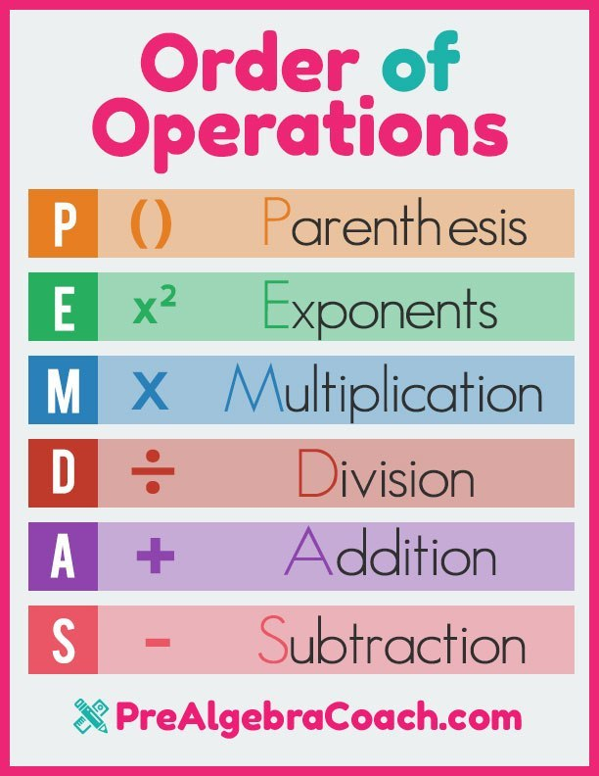
Expressions / Math Operations
expression: A data value or set of operations to compute a value.
Examples: 1 + 4 * 3
42
Arithmetic operators we will use:
+ - * / addition, subtraction/negation, multiplication, division
% modulus, a.k.a. remainder
** exponentiation
Order of Operations: PEMDAS
* / % ** have a higher precedence than + - 1 + 3 * 4 is 13
Parentheses can be used to force a certain order of evaluation. (1 + 3) * 4 is 16

Slide 9
Knowledge Check
Exercise: Modify your Python Omelette program.
Reply back with how many WHOLE omelettes they can make.
Tell the user how many eggs are left over.

Slide 10
Good to know Math Functions
Python has useful commands for performing calculations.
To use many of these commands, you must write the following at the top of your Python program:
from math import *
#"from", "import" are keywords, and "math" is the library to use; part of syntax
Command name | Description
abs(value) | absolute value
ceil(value) | rounds up
cos(value) | cosine, in radians
floor(value) | rounds down
log(value) | logarithm, base e
log10(value) | logarithm, base 10
max(value1, value2) | larger of two values
min(value1, value2) | smaller of two values
round(value) | nearest whole number
sin(value) | sine, in radians
sqrt(value) | square root

Slide 11
Knowledge Check
Exercise: Modify your Python Omelette program.
At 98 calories per egg, display the total calories per omelet.
At 6 grams of protein per egg, display the total protein per omelet.
Ask the user for additional ingredients for their omelet.
Display the additional ingredients
Round down the amount of eggs instead of using quotient.

